Slide 1
Cognitive ease at a cost
Stadler, Bannert & Sailer (2024): LLMs reduce mental effort but compromise depth in student scientific inquiry
1. What was done?
2. Concrete technology use
Randomized experimental lab study
Final sample: 91 students
Google Search vs. ChatGPT-3.5
20-min inquiry: nanoparticles in sunscreen
Then wrote a recommendation (without any support)
Outcomes: cognitive load + reasoning quality
Prior knowledge test
3. Main results
4. Why relevant?
ChatGPT group reported lower cognitive load
But produced weaker written justifications
Core trade-off: easier task, shallower reasoning
Fits meta-analysis finding: AI can reduce mental effort
Adds caution: lower effort is not always better learning
Human Factors: support vs. overreliance
5. Bias / limitations
6. Why special to me?
One university, short lab task, not a long classroom intervention
ChatGPT-3.5 only; newer models may differ
No classic pre-post learning measurement.
Prior knowledge was measured after the intervention.
As a student and mum, cognitive relief is attractive
But what thinking should AI not take over?
Takeaway: preserve productive struggle
AI should support thinking, not silently replace it.
Notes:
Problem: ChatGPT can make learning tasks easier, but easier does not always mean deeper.
Technology use: Students used either Google search or ChatGPT-3.5 for a 20-minute scientific inquiry task.
Main result: ChatGPT reduced cognitive load, but the reasoning quality of the final justification was weaker.
Critical point: The study has limits, but it makes the AI-in-education debate concrete and measurable.
Two independent raters coded the written justifications

Slide 2
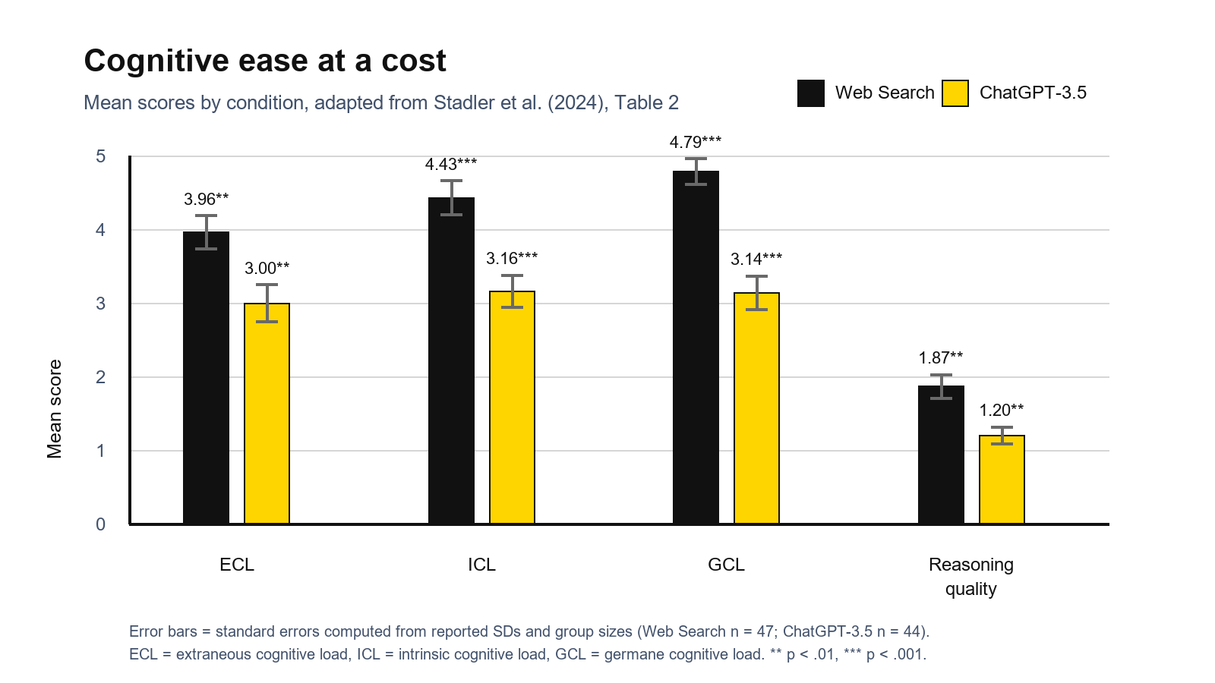
Cognitive ease at a cost
Lower effort is not automatically better learning: lower GCL may indicate less deep processing.
Notes:
Reducing useless load can help
Reducing productive effort can hurt
AI should support, not replace thinking
ICL: Load caused by content difficulty → “This task was very complex.”
ECL: Unnecessary extra load → How information is found or presented
GCL: Effort for understanding and connecting → Related to deeper processing
All loads are lower in the ChatGPT group

Slide 3
Study design: quality points
What is methodologically strong, and what should be interpreted carefully?
Strong: controlled task
Cognitive load
Same task and same time
Same lab environment
University computers
Measured directly after search
Questionnaire with 1-7 scale by Klepsch
ICL, ECL and GCL
Prior knowledge handling
Strong: coding quality
Medicine, pharmacy and biology excluded
Prior knowledge measured but afterwards
Controlled in ANCOVAs
Two independent raters
Justifications: k = .92
Recommendations: k = .89
Critical: sample and power
Critical: process insight
Small, non-representative sample
Only university students
No clear a-priori power analysis
No classic pre-post learning test
No think-aloud protocol
No search logs
Strong internal control, limited real-world generalizability.

